Slide 1
Recovery and Healing: Perspectives from those who have Struggled

Slide 2
Who AM I?

Slide 3
T.G.I.F

Slide 5
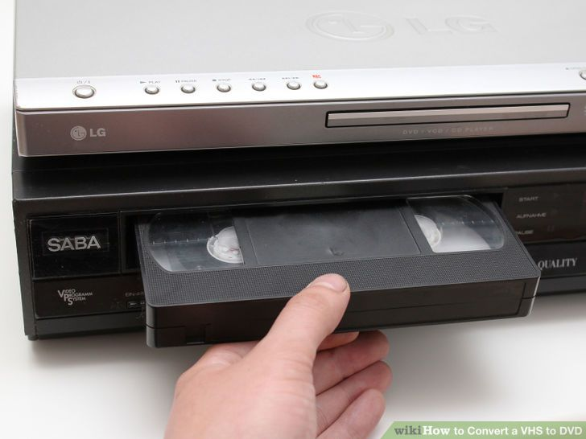
V.H.S

Slide 6
THE INTERNET

Slide 7
Mortal Sin
“A sin whose object is grave matter and which also committed with full knowledge and deliberate consent”-Catechism of the Catholic Church

Slide 8
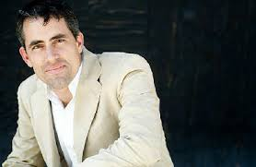
Tony Litster

Slide 9
What Porn Really is?

